Slide 1
SAP BTP Architect Training
Day 10
Anubhav Oberoy
www.AnubhavTrainings.com
Follow excellence with sheer passion

Slide 2


DISCLAIMER
The training content and delivery of this presentation is confidential, and cannot be recorded, or copied and distributed to any third party, without the written consent of Anubhav Trainings

Slide 3
Agenda – Day 10
01
04
Business processes
ES5 System access
02
05
Create workflow module and test
What is workflow
03
06
SAP Build process automation
Final Assessment

Slide 4
What is Business Process
In big organizations the large number of employees can only be managed when we have pre-defined, standardized processes. Processes in each area like leave request/approval, SRM purchasing, Order-to-cash, order approval, maintenance contract preparation, procure-to-pay, hiring.
Business process is the heart of an ERP system and a software which manages such business processes is called BPM.
It is in the best benefit of a company to comply to business process is to automate the same.
Classical SAP world (On-premised) we have SAP Workflow to automate a business process.
To create a workflow we use tcode as SWDD.
Workflow – Represents the steps of activities, these are called steps
Step – one activity in the flow, there are different step types
Step Type – indicates the type of activity e.g. send mail, user decision, tasks are created from the step type
Workflow instance – when we execute a workflow, a workflow instance is created (runtime of a workflow)
Context – Whenever we run a workflow at times we need data which float inside workflow, this data is held inside context, It’s the memory of workflow instance
Agent – person/user/entity to which a workflow task is assigned to. User needs to take an action so that workflow can continue.
At runtime, when a step type of task gets executed a work item gets created. This work item is sent to user’s inbox.

Slide 5
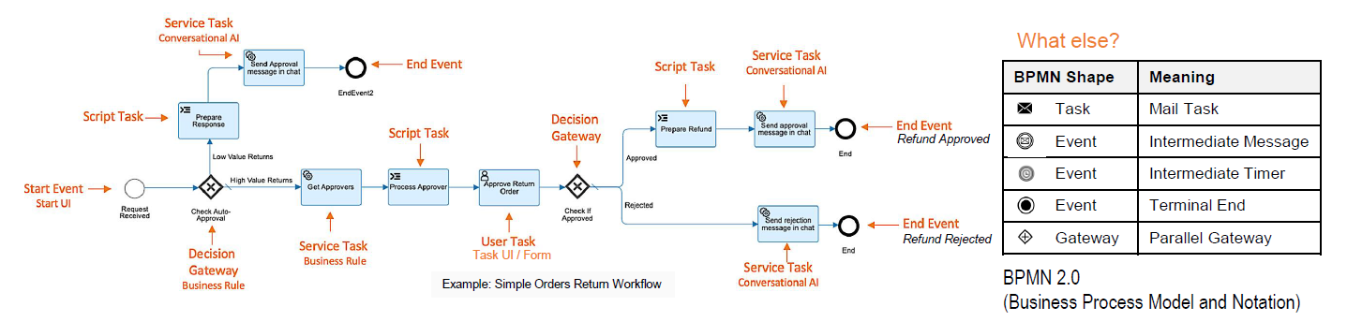
What is Business Workflow
A business workflow is a repeatable process that consists of a series of tasks that generally need to be completed in a specific sequence. Think of it as work flowing from one stage to the next until it is finished. Workflows are useful for ensuring that important processes are done the right way every time.

Slide 6
SAP BTP Business Process Automation
SAP Build Process Automation enables business users to automate workflow processes and tasks without writing code.
Automate Visually
Simplify automation with drag-and-drop and AI capabilities
Integrate Seamlessly
Develop faster using pre-built workflows, bots and connectors for SAP and non-SAP systems
Collaborate Securely
Enable fusion team development in a secure and agile fashion
SAP Build Process Automation combines workflow management, RPA functionality, decision management, process visibility, and embedded AI capabilities into one intuitive low-code experience. Learn how professional developers and business users can automate workflow processes and manual tasks with visual drag-and-drop tools.

Slide 7
Setup the ES5 demo system
An account on the SAP NetWeaver Gateway Demo system "ES5“ for the purpose of integration with workflow
Sign up here and then ensure your account is active and the username and password are correct, by checking you can access HTTP-based services such as
the EPM_REF_APPS_SHOP_SRV OData service.
If you find that you've forgotten your credentials for the ES5 system, you can visit the ES5 account administration page to get your password reset.

Slide 8
Change in workflow
2022 Dec
SAP BTP Workflow
BAS tool
(SAP BTP Platform)
SAP Workflow
(Business App Studio)
sapbwruntime
Sap build process automation
Sap build apps
Sap build work zone
SAP build
IRPA
https://help.sap.com/docs/workflow-management/sap-workflow-management/sap-workflow-management-path-forward

Slide 9
Hands-on
Enable SAP BTP Build Process Automation

Slide 10
Steps to get started with Workflow dev.
Open BAS tool and create dev space of type Fiori and choose the workflow module checkbox
Open sub-account and create a subscription of SAP Build workzone subscription and service instance
Create a subscription and a service for SAP Build process automation service
Created a service key for the build process automation service
To communicate to all workflow APIs instead of the workflowruntime service instance, we will need processautomation runtime service
Go to security and assign roles related to build process automation to our user – ProcessAutomationParticipant, ProcessAutomationDeveloper, ProcessAutomationAdmin
Open the BAS tool and create a project from template and choose MTA module
Right click on MTA.yml file and choose add mta module from template
The course will follow
If we want to get the tiles related to workflow in Build workzone, we have to first must follow the step 4, We need to create a destination in our BTP account so that the build workzone can pull over all the tiles related to workflow from sap repo. Click here
Import the destination sap_process_automation_service provided by Anubhav and replace all the properties from the service key of the processautomation service.
Go to build workzone and create a new site
Open channel manager and click refresh on html5 apps
Open the Content manager and choose the html5 apps, now you can see all the workflow tiles provided by SAP
Select all tiles and add them
Go to Everyone role, Edit and switch on all tiles. Create a catalog called Workflow and switch on all tiles, Repeat same by creating a group and switch on all tiles.

Slide 11
Continue..
Create and design the workflow, Joel expression documentation https://help.sap.com/docs/workflow-capability/workflow-neo/cheat-sheet-for-workflow-expressions?locale=en-US
Build and Deploy the workflow
To test the workflow, open the SAP Build process Automation cockpit and come down to Monitoring
Open process and workflows and you will find deployed workflow
Start a new instance and check if you receive the work item
We can monitor workflow using process and workflow instance tile in build process automation cockpit

Slide 12
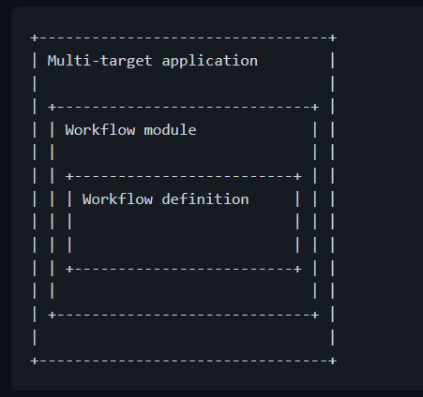
Initialize workflow module
Create a new multi target module project from template (welcome page)
Use F1 or choose View ➔ Find Command and select Open Template Wizard
Choose the template as @workflow/workflow
Provide the folder location of mta.yaml file
Enter the details of workflow module name, workflow name, description and choose create
A standard structure gets created.
A Multitarget application (MTA) is logically a single application comprised of multiple parts created with different technologies, which share the same lifecycle.
The developers of the MTA describe the desired result using the MTA model, which contains MTA modules, MTA resources, and interdependencies between them.
Afterward, the SAP BTP Deployment service validates, orchestrates, and automates the deployment of the MTA, which results in Cloud Foundry applications, services and SAP specific contents.

Slide 13
Workflow project structure
Project name
Forms folder which contains all the simple user interfaces, this constitutes a label and field pair.
Sample-data this folder contains our workflow data which needs to be circulated across all workflow steps. This data is always in JSON (Java Script Object Notation) format, and also known as context.
Scripts when we want to manipulate data during the workflow processing for imperative logic (if, looping, checks, calculation, manipulations) we need to use java script programming (js), these reusable files will be stored inside scripts folder
Webcontent this contains complex user interfaces, we use sap ui5 technology to develop these interfaces
Workflows this is the folder for all our workflows, which contains sequence of steps to automate business process. All the workflows have an extension called .workflow
Workflow module
forms
sample-data
scripts
webcontent
workflows
Anubhav.workflow
mta.yaml
Root directories
Project directories
Files

Slide 14
Assessment

Slide 18

What We Did
Let’s Summarize

Slide 19

www.anubhavtrainings.com
Thank You
End of Day 10

Slide 20


We’re committed to empower you to be
#FutureReady
through powerful training solutions.
We build the workforce of the future.
280+
Corporate Clients
80,000+
Learners Trained
28000+
Learners Placed
FREE WEBINARS
Sign up for free webinars with industry experts every fortnight!
Enroll Now!
Contact us today!
https://anubhavtrainings.com

